Slide 1

Q4
Quarterly Market Review
Fourth Quarter 2018

Slide 2
Quarterly Market Review
Fourth Quarter 2018
This report features world capital market performance and a timeline of events for the past quarter. It begins with a global overview, then features the returns of
stock and bond asset classes in the US and
international markets.
The report also illustrates the impact of globally diversified portfolios and features a quarterly topic.
Overview:
  Market Summary
  World Stock Market Performance
  World Asset Classes
  US Stocks
  International Developed Stocks
  Emerging Markets Stocks
  Select Country Performance
  Select Currency Performance vs. US Dollar
  Real Estate Investment Trusts (REITs)
  Commodities
  Fixed Income
  Global Fixed Income
  Impact of Diversification
  Quarterly Topic: Why Should You Diversify?

Slide 3
Quarterly Market Summary
Index Returns
Past performance is not a guarantee of future results. Indices are not available for direct investment. Index performance does not reflect the expenses associated with the management of an actual portfolio. Market segment (index representation) as follows: US Stock Market (Russell 3000 Index), International Developed Stocks (MSCI World ex USA Index [net div.]), Emerging Markets (MSCI Emerging Markets Index [net div.]), Global Real Estate (S&P Global REIT Index [net div.]), US Bond Market (Bloomberg Barclays US Aggregate Bond Index), and Global Bond Market ex US (Bloomberg Barclays Global Aggregate ex-USD Bond Index [hedged to USD]). S&P data © 2019 S&P Dow Jones Indices LLC, a division of S&P Global. All rights reserved. Frank Russell Company is the source and owner of the trademarks, service marks, and copyrights related to the Russell Indexes. MSCI data © MSCI 2019, all rights reserved. Bloomberg Barclays data provided by Bloomberg.

Slide 4
Long-Term Market Summary
Index Returns
Past performance is not a guarantee of future results. Indices are not available for direct investment. Index performance does not reflect the expenses associated with the management of an actual portfolio. Market segment (index representation) as follows: US Stock Market (Russell 3000 Index), International Developed Stocks (MSCI World ex USA Index [net div.]), Emerging Markets (MSCI Emerging Markets Index [net div.]), Global Real Estate (S&P Global REIT Index [net div.]), US Bond Market (Bloomberg Barclays US Aggregate Bond Index), and Global Bond Market ex US (Bloomberg Barclays Global Aggregate ex-USD Bond Index [hedged to USD]). S&P data © 2019 S&P Dow Jones Indices LLC, a division of S&P Global. All rights reserved. Frank Russell Company is the source and owner of the trademarks, service marks, and copyrights related to the Russell Indexes. MSCI data © MSCI 2019, all rights reserved. Bloomberg Barclays data provided by Bloomberg.

Slide 5
World Stock Market Performance
MSCI All Country World Index with selected headlines from Q4 2018
Oct Nov Dec
“US Unemployment Rate Falls to Lowest Level Since 1969”
“Mortgage Rates Fast Approaching 5%, a Fresh Blow to Housing Market”
“Eurozone Growth Stutters as US Economy Powers Ahead”
“Midterm Elections Produce a Divided Congress”
“US Stocks Hit Hard as Tech Worries Deepen”
“US, Mexico, and Canada Sign Pact to Replace NAFTA”
“Oil Prices Drop Sharply as OPEC Struggles to Agree on Cuts”
“May Survives a Party Revolt, But Brexit’s Path Is Unclear”
“IMF Lowers Global Growth Forecasts for 2018 and 2019”
“US Government Deficit Grew 17% in Fiscal 2018”
“Wages Rise at Fastest Rate in Nearly a Decade as Hiring Jumps”
“Japanese Economy Shrinks as Natural Disasters Take a Toll”
“Existing-Home Sales Suffer Largest Annual Drop in Four Years”
“French Antigovernment Protest Plunges Paris in Havoc”
“Small-Cap Stocks Teeter on the Edge of a Bear Market”
“US Indexes Close with Worst Yearly Losses Since 2008”
These headlines are not offered to explain market returns. Instead, they serve as a reminder that investors should view daily events from a long-term perspective and avoid making investment decisions based solely on the news.
Graph Source: MSCI ACWI Index [net div.]. MSCI data © MSCI 2019, all rights reserved.
It is not possible to invest directly in an index. Performance does not reflect the expenses associated with management of an actual portfolio. Past performance is not a guarantee of future results.

Slide 6
World Stock Market Performance
MSCI All Country World Index with selected headlines from past 12 months
Long Term (2000-Q4 2018)
Short Term (Q1 2018–Q4 2018)
Last 12 months
“Nasdaq Crests 7000 as Tech Giants Roar Into 2018”
“Congress Passes Mammoth Spending Bill, Averts Shutdown”
“Trump Pulls US Out of Iran Deal”
“Inflation Rate Hits Six-Year High in May”
“Profits Surge at Big US Firms”
“China’s Trade Surplus with US Hits New Record”
“US Unemployment Rate Falls to Lowest Level Since 1969”
“Midterm Elections Produce a Divided Congress”
“Oil Prices Drop Sharply as OPEC Struggles to Agree on Cuts”
“US Imposes New Tariffs, Ramping Up 'America First' Trade Policy”
“Yield on 10-Year US Government Bond Hits 3% for First Time in Years”
“US, China Tariffs Hit American-Made Products from Chips to Cars”
“US Jobless Claims Hit Lowest Level since 1969”
“Nasdaq Crosses 8000 Threshold for First Time”
“Fed Raises Interest Rates, Signals One More Increase This Year”
“Eurozone Growth Stutters as US Economy Powers Ahead”
“Existing-Home Sales Suffer Largest Annual Drop in Four Years”
“US Indexes Close with Worst Yearly Losses Since 2008”
These headlines are not offered to explain market returns. Instead, they serve as a reminder that investors should view daily events from a long-term perspective and avoid making investment decisions based solely on the news.
Graph Source: MSCI ACWI Index [net div.]. MSCI data © MSCI 2019, all rights reserved.
It is not possible to invest directly in an index. Performance does not reflect the expenses associated with management of an actual portfolio. Past performance is not a guarantee of future results.

Slide 7
World Asset Classes
Fourth Quarter 2018 Index Returns (%)
Equity markets around the world posted negative returns for the quarter. Looking at broad market indices, emerging markets outperformed developed markets, including the US.
Value stocks were positive vs. growth stocks in all markets, including the US. Small caps underperformed large caps in the US and non-US developed markets but outperformed in emerging markets.
REIT indices outperformed equity market indices in both the US and non-US developed markets.
Past performance is not a guarantee of future results. Indices are not available for direct investment. Index performance does not reflect the expenses associated with the management of an actual portfolio. The S&P data is provided by Standard & Poor's Index Services Group. Frank Russell Company is the source and owner of the trademarks, service marks, and copyrights related to the Russell Indexes. MSCI data © MSCI 2019, all rights reserved. Dow Jones data © 2019 S&P Dow Jones Indices LLC, a division of S&P Global. All rights reserved. S&P data © 2019 S&P Dow Jones Indices LLC, a division of S&P Global. All rights reserved. Bloomberg Barclays data provided by Bloomberg. Treasury bills © Stocks, Bonds, Bills, and Inflation Yearbook™, Ibbotson Associates, Chicago (annually updated work by Roger G. Ibbotson and Rex A. Sinquefield).

Slide 8
US Stocks
Fourth Quarter 2018 Index Returns
US equities underperformed both non-US developed and emerging markets.
Value outperformed growth in the US across large and small cap stocks.
Small caps underperformed large caps in the US.
  Ranked Returns for the Quarter (%)
  World Market Capitalization—US
  Period Returns (%)
Past performance is not a guarantee of future results. Indices are not available for direct investment. Index performance does not reflect the expenses associated with the management of an actual portfolio. Market segment (index representation) as follows: Marketwide (Russell 3000 Index), Large Cap (Russell 1000 Index), Large Cap Value (Russell 1000 Value Index), Large Cap Growth (Russell 1000 Growth Index), Small Cap (Russell 2000 Index), Small Cap Value (Russell 2000 Value Index), and Small Cap Growth (Russell 2000 Growth Index). World Market Cap represented by Russell 3000 Index, MSCI World ex USA IMI Index, and MSCI Emerging Markets IMI Index. Russell 3000 Index is used as the proxy for the US market. Frank Russell Company is the source and owner of the trademarks, service marks, and copyrights related to the Russell Indexes. MSCI data © MSCI 2019, all rights reserved.

Slide 9
International Developed Stocks
Firm Logo
Fourth Quarter 2018 Index Returns
In US dollar terms, developed markets outside the US outperformed the US equity market but underperformed emerging markets during the quarter.
Value outperformed growth across large and small cap stocks.
Small caps underperformed large caps in non-US developed markets.
  Ranked Returns for the Quarter (%)
Value
Large Cap
Growth
Small Cap
  World Market Capitalization—International Developed
  Period Returns (%)
Past performance is not a guarantee of future results. Indices are not available for direct investment. Index performance does not reflect the expenses associated with the management of an actual portfolio. Market segment (index representation) as follows: Large Cap (MSCI World ex USA Index), Small Cap (MSCI World ex USA Small Cap Index), Value (MSCI World ex USA Value Index), and Growth (MSCI World ex USA Growth Index). All index returns are net of withholding tax on dividends. World Market Cap represented by Russell 3000 Index, MSCI World ex USA IMI Index, and MSCI Emerging Markets IMI Index. MSCI World ex USA IMI Index is used as the proxy for the International Developed market. MSCI data © MSCI 2019, all rights reserved. Frank Russell Company is the source and owner of the trademarks, service marks, and copyrights related to the Russell Indexes.

Slide 10
Emerging Markets Stocks
Fourth Quarter 2018 Index Returns
In US dollar terms, emerging markets outperformed developed markets, including the US.
Value outperformed growth across large and small cap stocks.
Small caps outperformed large caps.
  Ranked Returns for the Quarter (%)
  World Market Capitalization—Emerging Markets
  Period Returns (%)
Past performance is not a guarantee of future results. Indices are not available for direct investment. Index performance does not reflect the expenses associated with the management of an actual portfolio. Market segment (index representation) as follows: Large Cap (MSCI Emerging Markets Index), Small Cap (MSCI Emerging Markets Small Cap Index), Value (MSCI Emerging Markets Value Index), and Growth (MSCI Emerging Markets Growth Index). All index returns are net of withholding tax on dividends. World Market Cap represented by Russell 3000 Index, MSCI World ex USA IMI Index, and MSCI Emerging Markets IMI Index. MSCI Emerging Markets IMI Index used as the proxy for the emerging market portion of the market. MSCI data © MSCI 2019, all rights reserved. Frank Russell Company is the source and owner of the trademarks, service marks, and copyrights related to the Russell Indexes.

Slide 11
Select Country Performance
Fourth Quarter 2018 Index Returns
In US dollar terms, New Zealand and Hong Kong recorded the highest country performance in developed markets, while Austria and Norway posted the lowest returns for the quarter. In emerging markets, Brazil and Indonesia recorded the highest country performance, while Columbia and Pakistan posted the lowest performance.
Ranked Developed Markets Returns (%)
Ranked Emerging Markets Returns (%)
Past performance is not a guarantee of future results. Indices are not available for direct investment. Index performance does not reflect the expenses associated with the management of an actual portfolio. Country performance based on respective indices in the MSCI World ex US IMI Index (for developed markets), MSCI USA IMI Index (for US), and MSCI Emerging Markets IMI Index. All returns in USD and net of withholding tax on dividends. MSCI data © MSCI 2019, all rights reserved. UAE and Qatar have been reclassified as emerging markets by MSCI, effective May 2014.

Slide 12
Select Currency Performance vs. US Dollar
Fourth Quarter 2018
In developed markets, currencies mostly depreciated vs. the US dollar with a few exceptions, including the Japanese yen, which appreciated over 3.5%. In emerging markets, currencies were mixed against the US dollar, ranging from +12% to –10%.
Ranked Developed Markets (%)
Ranked Emerging Markets (%)
Past performance is not a guarantee of future results. Indices are not available for direct investment. Index performance does not reflect the expenses associated with the management of an actual portfolio.
MSCI data © MSCI 2019, all rights reserved.

Slide 13
Real Estate Investment Trusts (REITs)
Fourth Quarter 2018 Index Returns
Non-US real estate investment trusts outperformed US REITs in US dollar terms.
  Ranked Returns for the Quarter (%)
  Total Value of REIT Stocks
  Period Returns (%)
Past performance is not a guarantee of future results. Indices are not available for direct investment. Index performance does not reflect the expenses associated with the management of an actual portfolio. Number of REIT stocks and total value based on the two indices. All index returns are net of withholding tax on dividends. Total value of REIT stocks represented by Dow Jones US Select REIT Index and the S&P Global ex US REIT Index. Dow Jones US Select REIT Index used as proxy for the US market, and S&P Global ex US REIT Index used as proxy for the World ex US market. Dow Jones and S&P data © 2019 S&P Dow Jones Indices LLC, a division of S&P Global. All rights reserved.

Slide 14
Commodities
Fourth Quarter 2018 Index Returns
The Bloomberg Commodity Index Total Return declined 9.41% during the fourth quarter of 2018, bringing the total annual return to –11.25%.
Sugar led quarterly performance with a gain of 7.41%. Energy was the worst-performing complex, with WTI crude oil and unleaded gas declining by 37.87% and 37.78%, respectively.
Ranked Returns for Individual Commodities (%)
Show Qtr for commodities
Period Returns (%)
Past performance is not a guarantee of future results. Index is not available for direct investment. Index performance does not reflect the expenses associated with the management of an actual portfolio.
Commodities returns represent the return of the Bloomberg Commodity Total Return Index. Individual commodities are sub-index values of the Bloomberg Commodity Total Return Index. Data provided by Bloomberg.

Slide 15
Fixed Income
Fourth Quarter 2018 Index Returns
Interest rate changes across the US fixed income market were mixed during the fourth quarter of 2018. The yield on the 5-year Treasury note declined 43 basis points (bps), ending the quarter at 2.51%. The yield on the 10-year Treasury note decreased 36 bps to 2.69%. The 30-year Treasury bond yield decreased 17 bps to finish at 3.02%. For 2018, yields on the 10-year Treasury and 30-year Treasury increased 29 bps and 28 bps, respectively.
In terms of total returns, short-term corporate bonds increased 0.78% during the quarter. Intermediate-term corporate bonds had a total return of 0.58%.
Total returns for short-term municipal bonds were 1.10% for the quarter. Intermediate-term municipal bonds returned 2.00%.
US Treasury Yield Curve (%)
Bond Yield across Issuers (%)
Period Returns (%)
One basis point equals 0.01%. Past performance is not a guarantee of future results. Indices are not available for direct investment. Index performance does not reflect the expenses associated with the management of an actual portfolio. Yield curve data from Federal Reserve. State and local bonds are from the S&P National AMT-Free Municipal Bond Index. AAA-AA Corporates represent the Bank of America Merrill Lynch US Corporates, AA-AAA rated. A-BBB Corporates represent the ICE BofAML Corporates, BBB-A rated. Bloomberg Barclays data provided by Bloomberg. US long-term bonds, bills, inflation, and fixed income factor data © Stocks, Bonds, Bills, and Inflation (SBBI) Yearbook™, Ibbotson Associates, Chicago (annually updated work by Roger G. Ibbotson and Rex A. Sinquefield). FTSE fixed income indices © 2019 FTSE Fixed Income LLC, all rights reserved. ICE BofAML index data © 2019 ICE Data Indices, LLC. S&P data © 2019 S&P Dow Jones Indices LLC, a division of S&P Global. All rights reserved.

Slide 16
Global Fixed Income
Fourth Quarter 2018 Yield Curves
Interest rates in the global developed markets generally decreased during the quarter.
Longer-term bonds generally outperformed shorter-term bonds in the global developed markets.
For the year, longer-term bonds underperformed shorter-term bonds in the US but generally outperformed shorter-term bonds in the non-US developed markets.
US
UK
Germany
Japan
One basis point equals 0.01%. Source: ICE BofAML government yield. ICE BofAML index data © 2019 ICE Data Indices, LLC.

Slide 17
Impact of Diversification
Fourth Quarter 2018 Index Returns
These portfolios illustrate the performance of different global stock/bond mixes and highlight the benefits of diversification. Mixes with larger allocations to stocks are considered riskier but have higher expected returns over time.
  Ranked Returns (%)
  Growth of Wealth: The Relationship between Risk and Return
Stock/Bond Mix
  Period Returns (%)
100% Stocks
75/25
50/50
25/75
100% Treasury Bills
1. STDEV (standard deviation) is a measure of the variation or dispersion of a set of data points. Standard deviations are often used to quantify the historical return volatility of a security or portfolio.
Diversification does not eliminate the risk of market loss. Past performance is not a guarantee of future results. Indices are not available for direct investment. Index performance does not reflect expenses associated with the management of an actual portfolio. Asset allocations and the hypothetical index portfolio returns are for illustrative purposes only and do not represent actual performance. Global Stocks represented by MSCI All Country World Index (gross div.) and Treasury Bills represented by US One-Month Treasury Bills. Globally diversified allocations rebalanced monthly, no withdrawals. Data © MSCI 2019, all rights reserved. Treasury bills © Stocks, Bonds, Bills, and Inflation Yearbook™, Ibbotson Associates, Chicago (annually updated work by Roger G. Ibbotson and Rex A. Sinquefield).

Slide 18
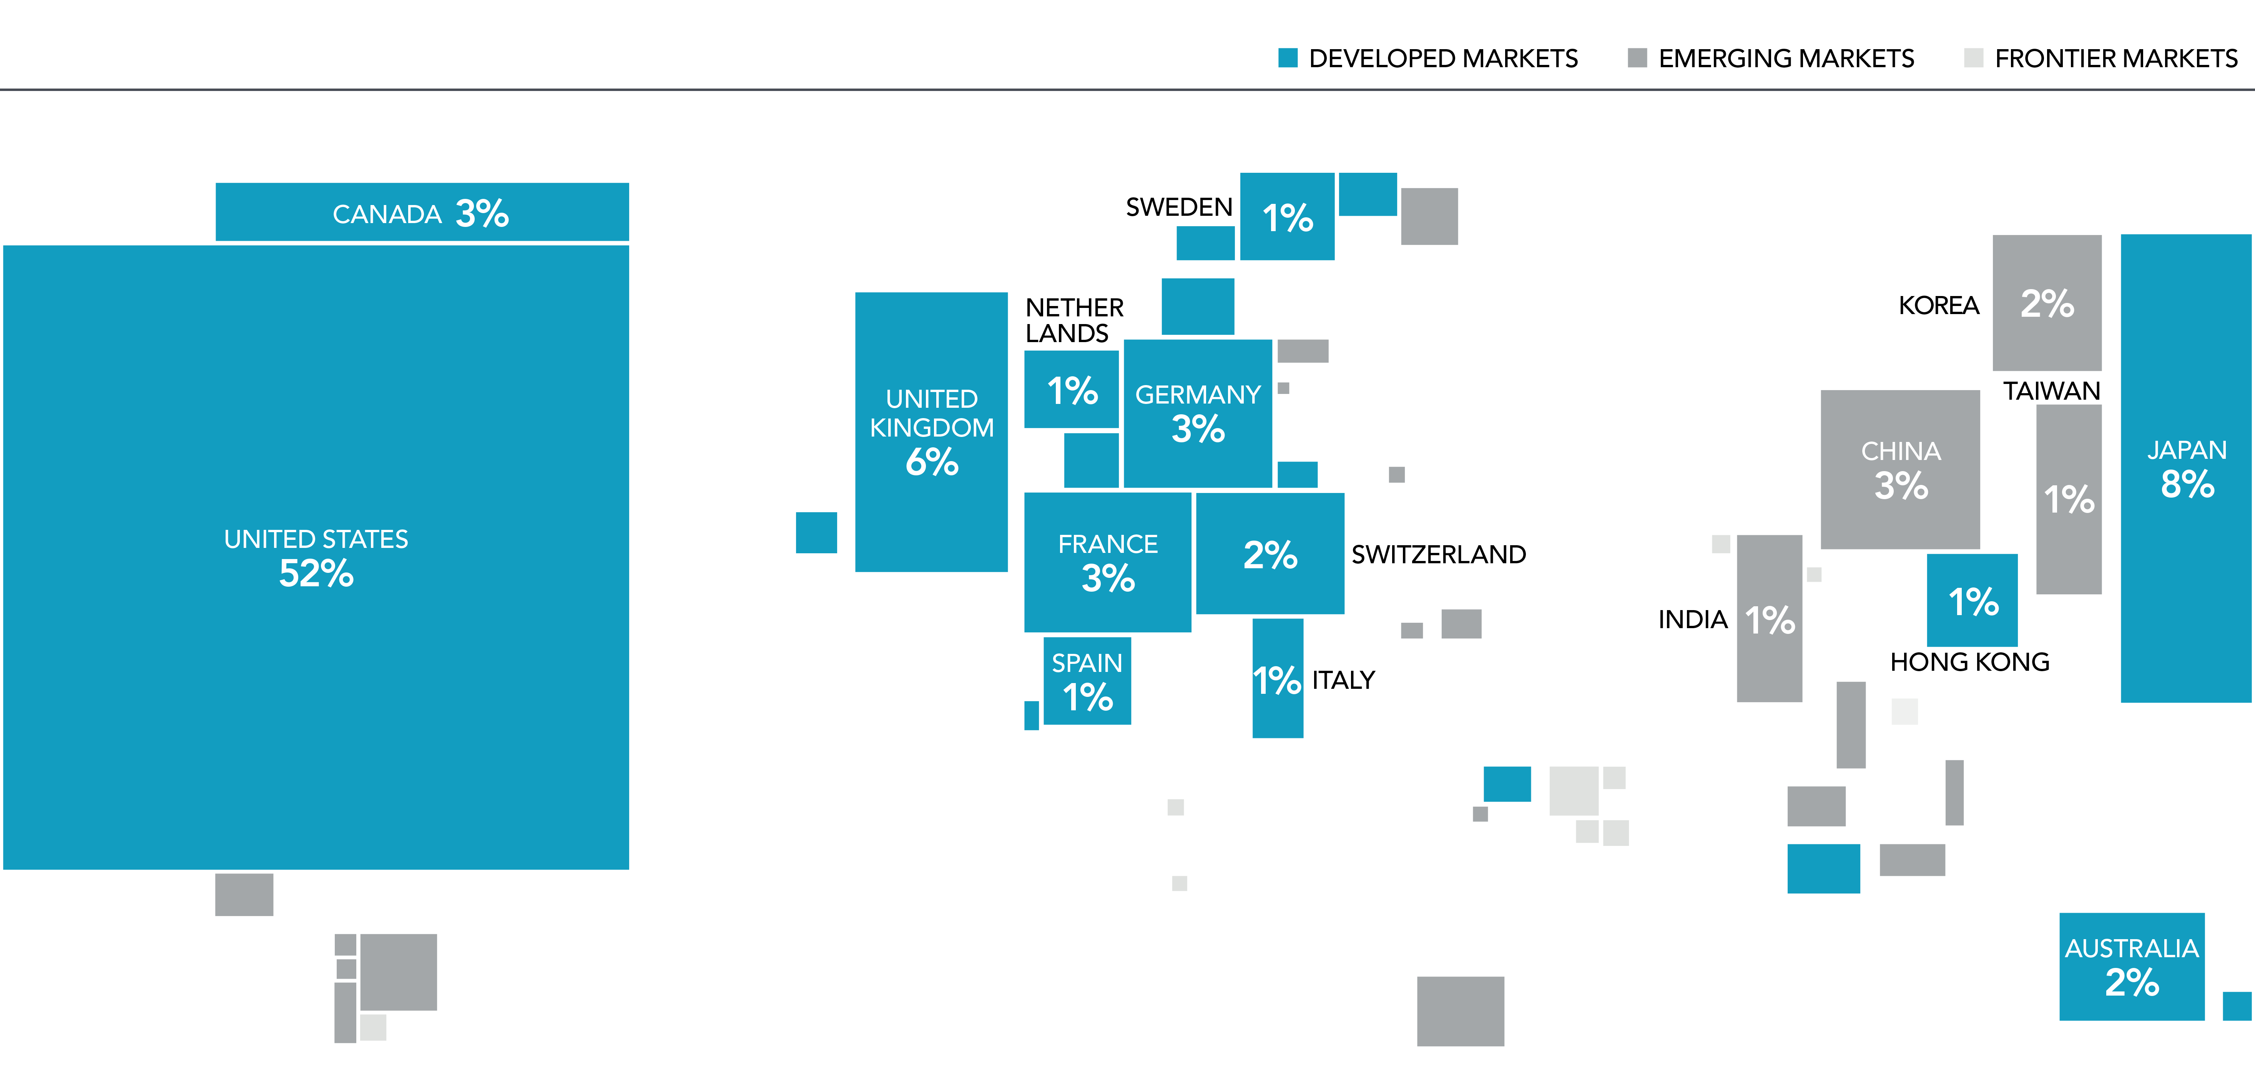
Why Should You Diversify?
Fourth Quarter 2018
    As 2019 approaches, and with US stocks outperforming non-US stocks in recent years,
    some investors have again turned their attention towards the role that global diversification plays in their portfolios.
For the five-year period ending October 31, 2018, the S&P 500 Index had an annualized return of 11.34% while the MSCI World ex USA Index returned 1.86%, and the MSCI Emerging Markets Index returned 0.78%. As US stocks have outperformed international and emerging markets stocks over the last several years, some investors might be reconsidering the benefits of investing outside the US.
While there are many reasons why a US-based investor may prefer a degree of home bias in their equity allocation, using return differences over a relatively short period as the sole input into this decision may result in missing opportunities that the global markets offer. While international and emerging markets stocks have delivered disappointing returns relative to the US over the last few years, it is important to remember that:
Non-US stocks help provide valuable diversification benefits.
Recent performance is not a reliable indicator
of future returns.
  there’s a world of opportunity in equities
The global equity market is large and represents a world of investment opportunities. As shown in Exhibit 1, nearly half of the investment opportunities in global equity markets lie outside
the US. Non-US stocks, including developed and emerging markets, account for 48% of world market capitalization¹ and represent thousands of companies in countries all over the world. A portfolio investing solely within the US would not be exposed to the performance of those markets.
Exhibit 1. World Equity Market Capitalization
As of December 31, 2017. Data provided by Bloomberg. Market cap data is free-float adjusted and meets minimum liquidity and listing requirements. China market capitalization excludes A-shares, which are generally only available to mainland China investors. For educational purposes; should not be used as investment advice.
1. The total market value of a company’s outstanding shares, computed as price times shares outstanding.

Slide 19
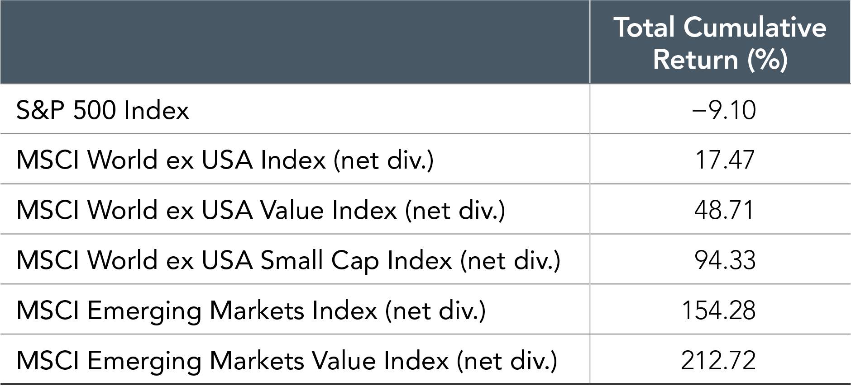
Why Should You Diversify?
(continued from page 18)
  the lost decade
We can examine the potential opportunity cost associated with failing to diversify globally by reflecting on the period in global markets from 2000–2009. During this period, often called the “lost decade” by US investors, the S&P 500 Index recorded its worst ever 10-year performance with a total cumulative return of –9.1%. However, looking beyond US large cap equities, conditions were more favorable for global equity investors as most equity asset classes outside the US generated positive returns over the course of the decade. (See Exhibit 2.) Expanding beyond this period and looking at performance for each of the 11 decades starting in 1900 and ending in 2010, the US market outperformed the world market in five decades and underperformed in the other six.² This further reinforces why an investor pursuing the equity premium should consider a global allocation. By holding a globally diversified portfolio, investors are positioned to capture returns wherever they occur.
  pick a country?
Are there systematic ways to identify which countries will outperform others in advance? Exhibit 3 illustrates the randomness in country equity market rankings (from highest to lowest) for 22 different developed market countries over the past 20 years. This graphic conveys how difficult it would be to execute a strategy that relies on picking the best country and the resulting importance of diversification.
In addition, concentrating a portfolio in any one country can expose investors to large variations in returns. The difference between the best- and worst‑performing countries can be significant. For example, since 1998, the average return of the best‑performing developed market country was approximately 44%, while the average return of the worst-performing country was approximately –16%. Diversification means an investor’s portfolio is unlikely to be the best or worst performing relative to any individual country, but diversification also provides a means to achieve a more consistent outcome and more importantly helps reduce and manage catastrophic losses that can be associated with investing in just a small number of stocks or a single country.
  a diversified approach
Over long periods of time, investors may benefit from consistent exposure in their portfolios to both US and non‑US equities. While both asset classes offer the potential to earn positive expected returns in the long run, they may perform quite differently over short periods. While the performance of different countries and asset classes will vary over time, there is no reliable evidence that this performance can be predicted in advance. An approach to equity investing that uses the global opportunity set available to investors can provide diversification benefits as well as potentially higher expected returns.
Exhibit 2. Global Index Returns, January 2000–December 2009
S&P data © 2019 S&P Dow Jones Indices LLC, a division of S&P Global. All rights reserved. MSCI data © MSCI 2019, all rights reserved. Indices are not available for direct investment. Index performance does not reflect expenses associated with the management of an actual portfolio. Past performance is not a guarantee of future results.
2. Source: Annual country index return data from the Dimson-Marsh-Staunton (DMS) Global Returns Data, provided by Morningstar, Inc.

Slide 20
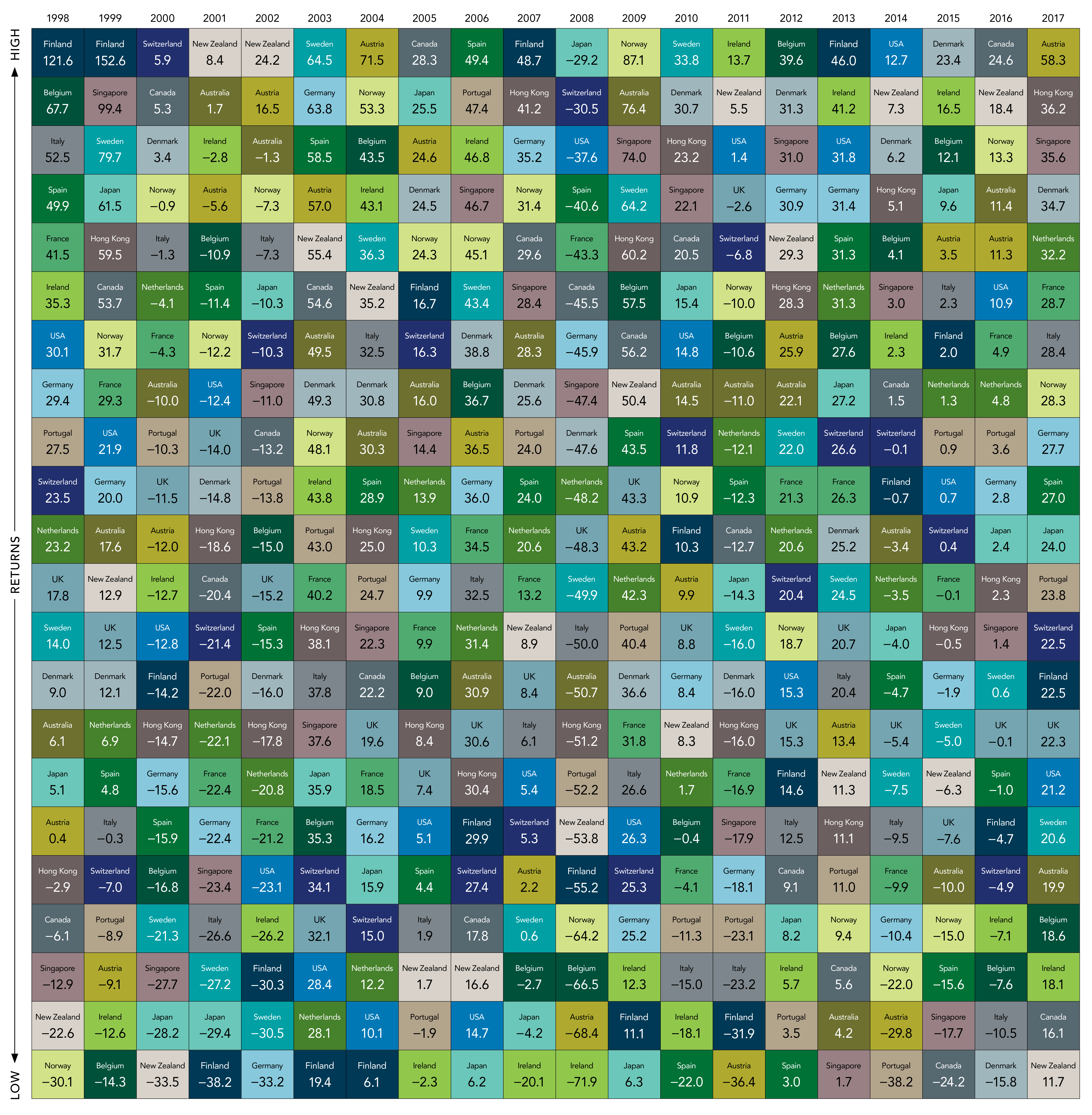
Why Should You Diversify?
(continued from page 19)
Exhibit 3. Equity Returns of Developed Markets
Source: MSCI country indices (net dividends) for each country listed. Does not include Israel, which MSCI classified as an emerging market prior to May 2010. MSCI data © MSCI 2019, all rights reserved. Past performance is no guarantee of future results. Indices are not available for direct investment; therefore, their performance does not reflect the expenses associated with the management of an actual portfolio.
Source: Dimensional Fund Advisors LP.
Indices are not available for direct investment. Their performance does not reflect the expenses associated with the management of an actual portfolio. Past performance is not a guarantee of future results. Diversification does not eliminate the risk of market loss.
There is no guarantee investment strategies will be successful. Investing involves risks, including possible loss of principal. Investors should talk to their financial advisor prior to making any investment decision.
All expressions of opinion are subject to change. This article is distributed for informational purposes, and it is not to be construed as an offer, solicitation, recommendation, or endorsement of any particular security, products, or services. Investors should talk to their financial advisor prior to making any investment decision

